Slide 1

Data Mining for Business Dashboard Examples

Slide 2
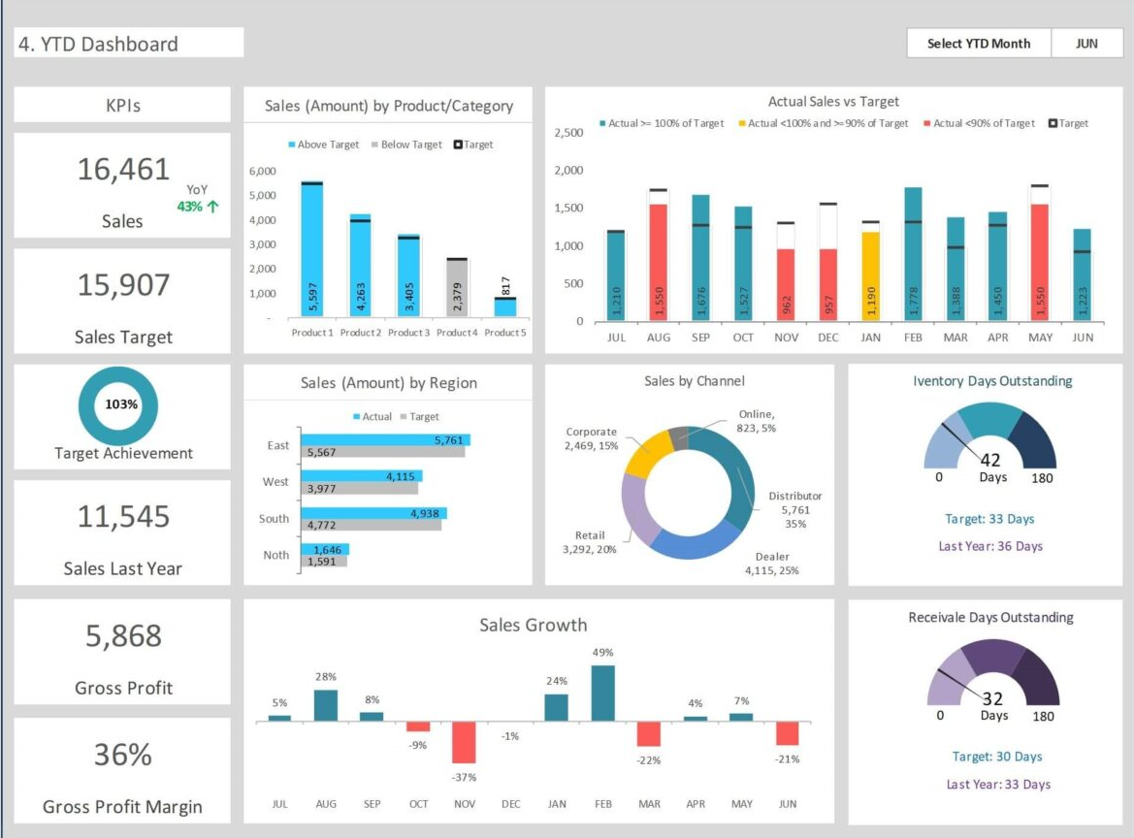




Source: Internet
Sales Intelligence Tool
Filters

Slide 3
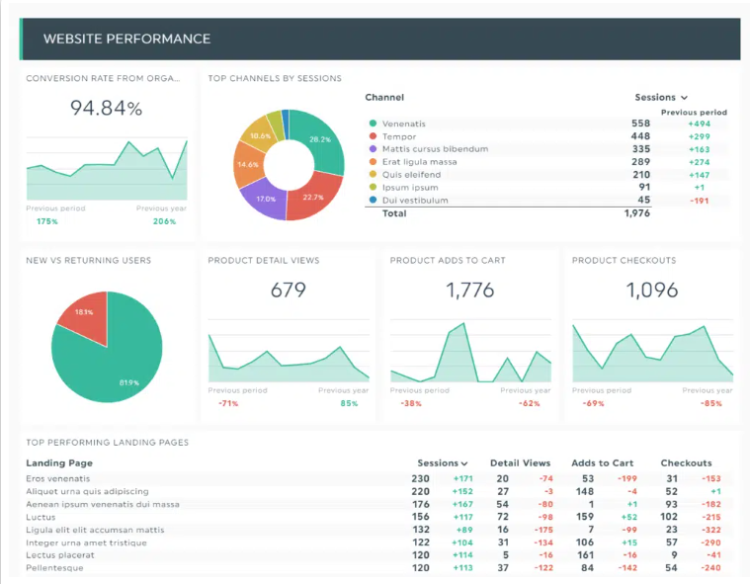
Source: Internet

Slide 4
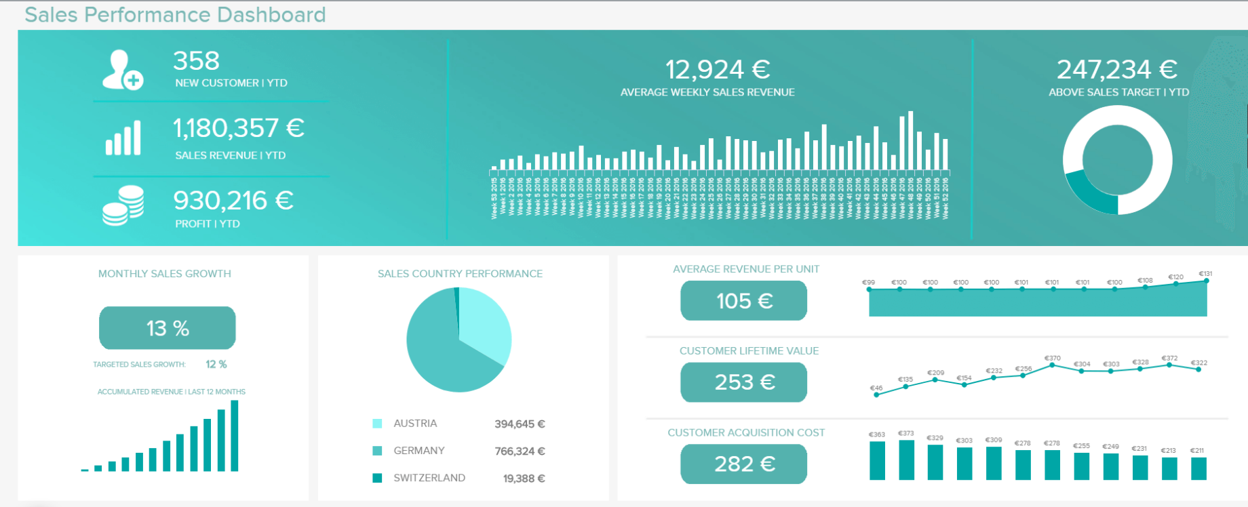
Source: Internet

